Slide 1

Machine learning for spatiotemporal PM_{2.5} estimates across the western US, 2008-2014
Melissa May Maestas, PhD
Research Associate (Post-Doctoral)
CU Boulder, CIRES, Earth Lab
International Workshop on Air Quality Forecasting Research
November 9, 2018
Boulder, CO
Colleen Reid, PhD
Institute for Behavioral Science & Geography
Ellen Considine
BS-candidate
Gina Li
MA-candidate
Image: https://www.nasa.gov/image-feature/nasas-science-aircraft-flies-over-thomas-fire-in-california

Slide 2
Why wildfires?
Globally and regionally, wildfire risk is projected to increase under various potential future climate scenarios.
The percent of our air pollution due to wildfires will likely increase, not just from climatic changes, but also because of declines in other sources of air pollution
Image: McClure and Jaffe, 2018. www.pnas.org/cgi/doi/10.1073/pnas.1804353115
Notes:
Caption from paper: Fig. 1. The 98th Quantile Regression of PM2.5 trends. Observed PM trends for 1988–2016 (calculated using QR methods) from IMPROVE sites are shown by
black dots with corresponding values in μg·m−3·y−1. Krige-interpolated values (calculated from observed data) are shown by the color ramp. Solid black lines
with arrows (indicating direction) show the boundary where the Krige-interpolated PM2.5 trends within have a 90% probability of being positive or negative.
Of the 157 sites, 92 show statistical significance (8 positive/84 negative).

Slide 3
What are the health effects from exposure to wildfire smoke?
Clear evidence of respiratory health effects
Particularly for exacerbation of asthma, COPD
Growing evidence of increased risk of all-cause mortality
Mixed findings for cardiovascular outcomes
A few studies have found associations with adverse birth outcomes
More research needed
→ more research needed for health outcomes not yet studied or understudied
→ to further evaluate cardiovascular outcomes
→ to better understand effects of duration and intensity of wildfire smoke exposures
→ to identify vulnerable subpopulations
Source: Reid et al. 2016. Critical review of health impacts of wildfire smoke exposure. Environmental Health Perspectives
Notes:
From a health perspective, there are impacts on the people living closest to the fire in terms of loss of life and psychological trauma from living through an extreme weather event, and from wildland firefighters in terms of their inhalation and physical exposures to fire, however, my talk today is concerned with the effects on the population living downwind and experiencing higher than average air pollution exposures. From a review of the literature on this, my colleagues and I found….

Slide 4
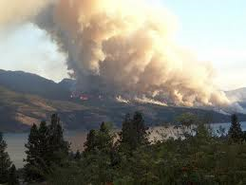
Exposure assessment difficulties
Sparse air pollutant monitoring network
Many PM_{2.5} monitors only measure every sixth or third day
Leads to spatial and temporal averaging of exposure measurements
But, smoke plumes migrate quickly, changing exposures over smaller spatial and temporal scales
Notes:
One of the things that came up in my own epidemiological investigations into the health effects of wildland fire smoke was exposure assessment difficulties.

Slide 5
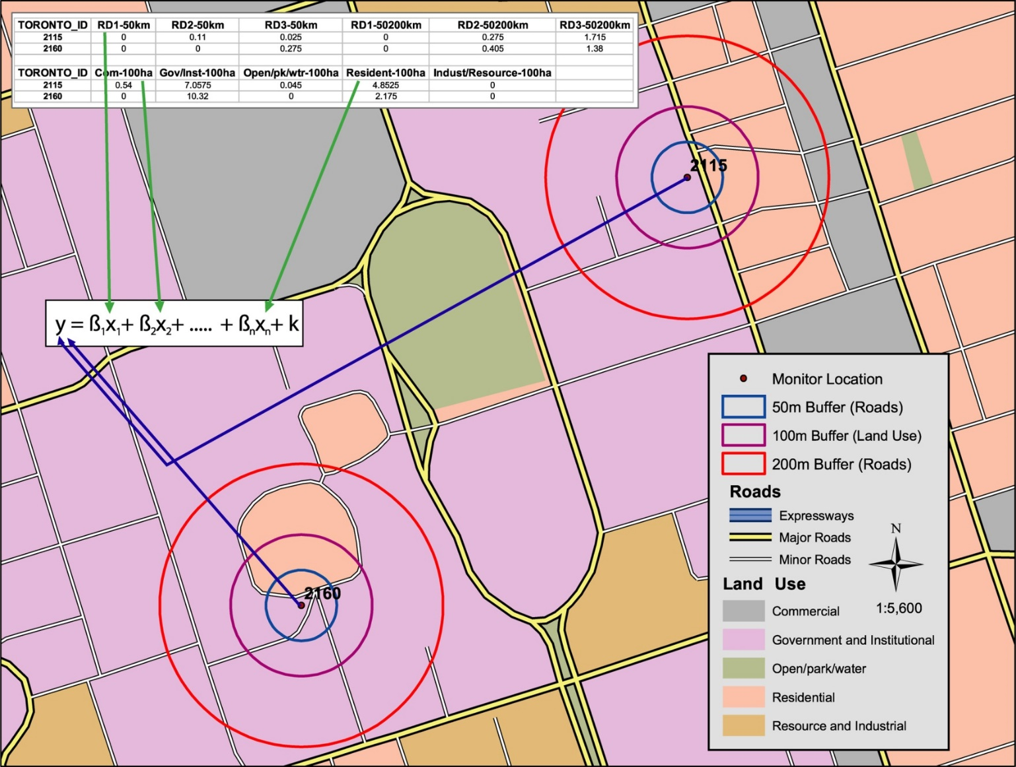
Methods – adapt land use regression modeling with machine learning
Include novel spatiotemporal datasets
Apply machine learning methods to
Select from a long list of predictor variables
Select from a variety of statistical algorithms
Image courtesy of Mike Jerrett
Notes:
I bring in the text box to say ways in which I adapted land use regression for this purpose – instead of long-term average, used spatiotemporal predictors to allow daily estimation and used machine learning to select between a lot of non-linear models

Slide 6
2008 ML project and new ML project
New Study – Scaling up:
Similar modeling (Di paper (Harvard, Emory)) – models don’t perform well in western US
We’re focusing on western US
More than EPA monitors (FS, TEOM, states, FS, field campaignes
Plug – if you have PM2.5 monitor data – we would like to include it in our study
Hope to do ensemble of different machine learning algorithms

Slide 7
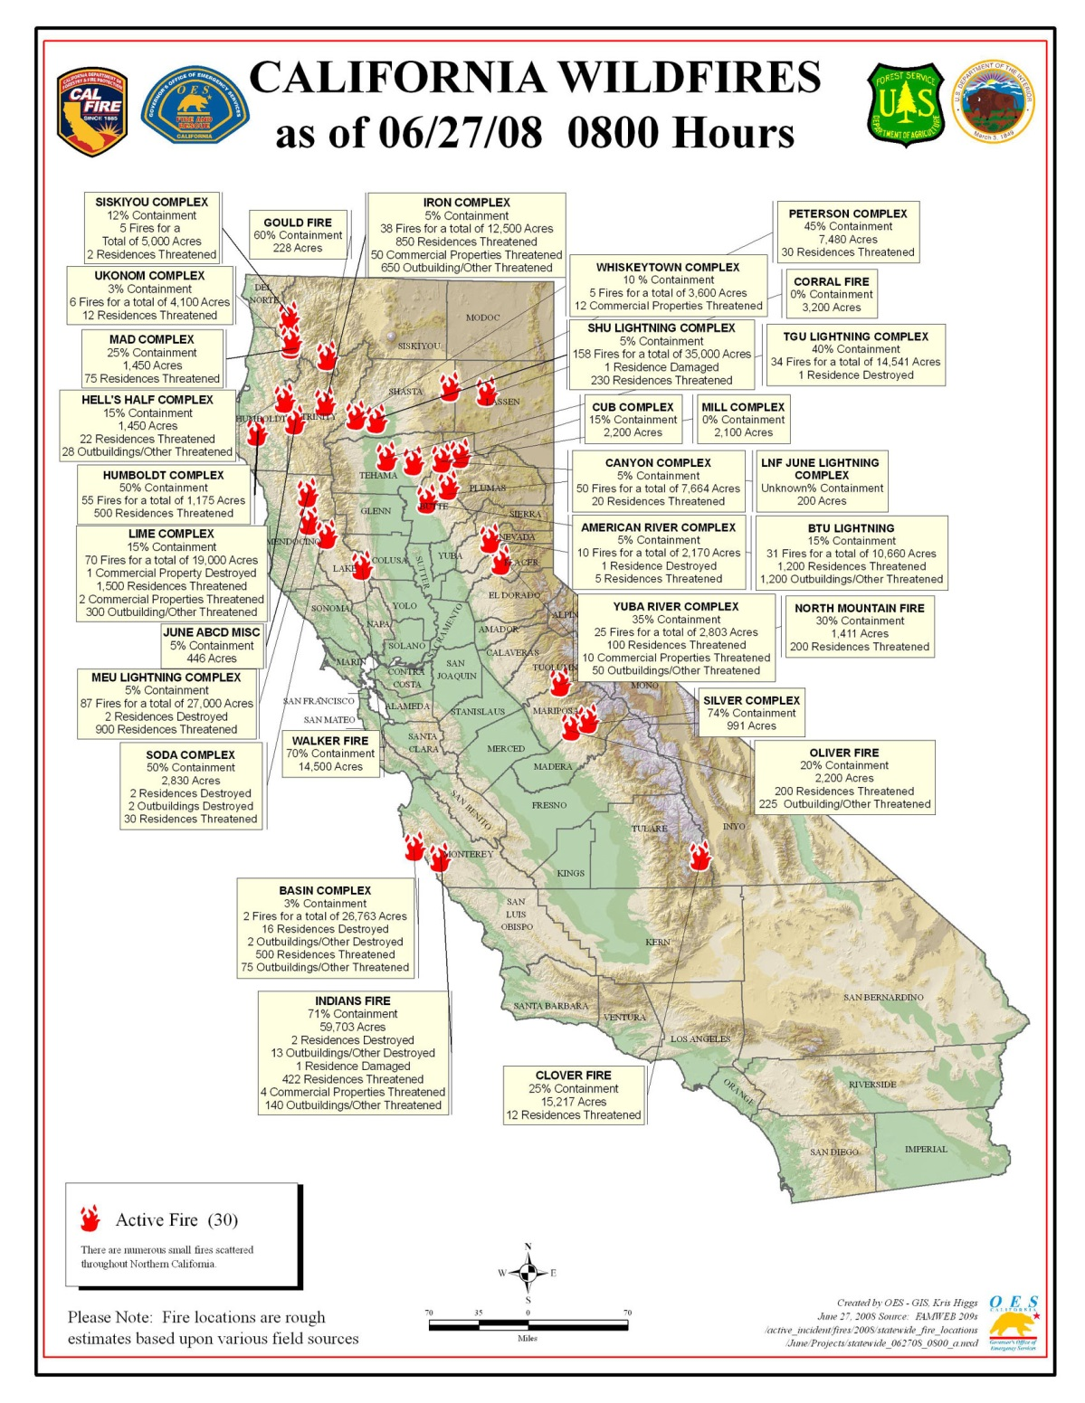
2008 northern California wildfires
Lightning storm on June 20-21, 2008
Over 6000 lightning strikes
Thousands of fires
Smoke covered large population areas for weeks (est. 10-12 million people exposed)
Potential for adverse health effects on large population
Notes:
I became interested in this when I was working for the EPA in San Francisco – there had just been an intense wildfire that had caused many people to call in to the air office complaining of the health impacts. But the air team had no idea if this was

Slide 8
2008-2014 Western US

Slide 9
Variables | Data Source |  | Temporal Resolution | Spatial Resolution
Dependent Variable
PM_{2.5} from monitoring stations (N=121) | US EPA, California Air Resources Board, Air Districts, and US Forest Service |  | Daily or hourly
Spatiotemporal Variables
GASP AOD | National Oceanic and Atmospheric Administration |  | Half-hourly, daylight | 4 km
MODIS AOD | NASA |  | Twice daily | 10 km
Local AOD | Sonoma Technology, Inc. |  | Daily | 0.5 km
WRF-Chem PM_{2.5} (µg/m³) | National Center for Atmospheric Research |  | Hourly | 12 km
Distance to nearest cluster of active fires (m) Counts of fires in nearest cluster / distance | Derived from USDA Forest Service Remote Sensing Applications Center |  | Daily
Relative Humidity (%) Sea level pressure (Pa) Surface pressure (Pa) Planetary boundary layer height (m) U-component of wind speed (m/s) V-component of wind speed (m/s) Dew point temperature (K) Temperature at 2 m (K) | Rapid Update Cycle |  | Daily | 13 km
Spatial Variables
X-coordinate (m) Y-coordinate (m) | U.S. Environmental Protection Agency Air Quality System
Counts of traffic within 1 km | Dynamap 2000, TeleAtlas |  | Annual | 1 km
% of urban land use within 1km % of agricultural land use within 1km % of vegetation land use within 1km Any High intensity land use within 1km | 2006 National Land Cover Database |  |  | 1 km
Elevation (m) | National Elevation Dataset 2010
Binary indicator variables for air basin | California Air Resources Board |  |  | Air Basin
Population Density | U.S. Census 2000 |  |  | Block Group
Temporal Variables
Julian Date Weekend |  |  | Daily
Reid et al. 2015. Environmental Science & Technology
Notes:
We amassed a very large dataset to do this

Slide 10
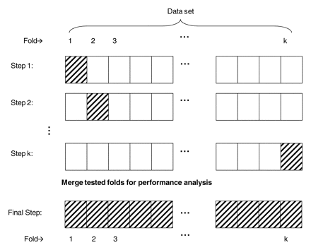
Statistical Methods – Machine Learning
29 predictor variables
121 monitoring locations
11 statistical algorithms
10-fold cross validation within each algorithm
To choose the covariates
To choose the tuning parameters of the algorithm
Minimize the CV-RMSE
Caret package in R
Functions rfe and train

Slide 11
Status of Project

Slide 12
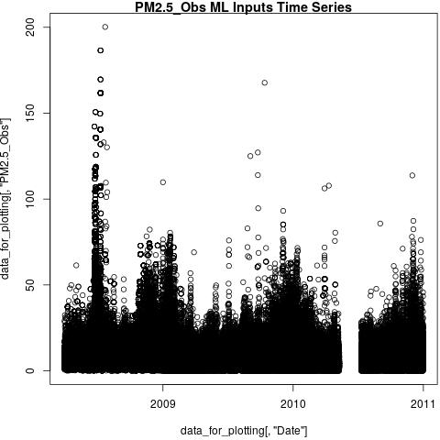
PM2.5 Time series

Slide 13
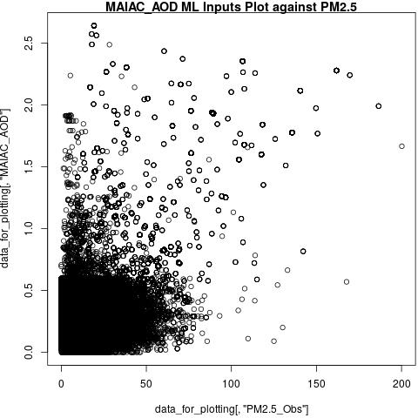
MAIAC AOD

Slide 14
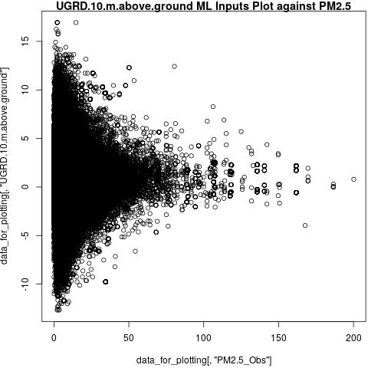
A check on the data: Higher PM2.5 with calm winds

Slide 15
PM2.5 Observations and predictions
County choropleth of observations (mean) – July 11, 2008
County choropleth of predictions – July 11, 2008

Slide 16
Next Steps and Future Plans
Finish data assimilation
❋ Looking for more PM_{2.5} data ❋
ML modeling
Ensemble modeling
Random Forest, others
Cross validation by region/time instead of 10-fold
Model by Region: Predictor relationships could be different
Pull in CTM model output
❋ Looking for available data ❋
Connect ML estimates to medical data for epidemiological analysis
Flexible Geographic Resolution
County centroid
Population-weighted county centroid
ZIP code
Geo-coded address

Slide 17
Thank You!! Questions?
Melissa May Maestas, PhD Melissa.Maestas@Colorado.edu
Colleen Reid, PhD Colleen.Reid@Colorado.edu
Ellen Considine, BS-candidate
Gina Li, MA-candidate

Slide 18
Extra Slides

Slide 19
Source: Reid et al. 2015. Spatiotemporal Prediction of Fine Particulate Matter During the 2008 Northern California Wildfires Using Machine Learning. Environmental Science & Technology.

Slide 20
Predictions for the top two models agreed with visible imagery
Source: Reid et al. 2015. Spatiotemporal Prediction of Fine Particulate Matter During the 2008 Northern California Wildfires Using Machine Learning. Environmental Science & Technology.
Notes:
With noted discrepancies due to the one time point of the visible imagery and the model was for a 24-hour average, and also the discrepancy of visible could have more smoke aloft whereas the model was trained to best estimate exposures at ground-level.

Slide 21
Variable Importance
Average Variable Importance
GASP AOD | 1088.40
distance to the nearest fire cluster | 327.99
WRF-Chem | 266.49
Julian date | 263.31
Surface pressure | 201.03
Local AOD | 195.17
sea level pressure | 182.81
Relative humidity | 175.75
V component of wind speed | 157.06
U component of wind speed | 135.87
X-coordinate | 134.86
MODIS AOD | 130.63
temperature at 2 meters | 116.02
Y-coordinate | 122.27
dew point temperature | 96.16
fire counts in nearest cluster / distance | 95.87
elevation | 75.52
planetary boundary layer height | 84.49
% urban land use within 1 km | 72.40
sum of traffic counts within 1 km | 71.98
% vegetated land use within 1 km | 37.64
Reid et al. 2015. Environmental Science & Technology

Slide 22
Reid et al. 2015. Environmental Science & Technology
Notes:
We also ran the model with fewer inputs and it could still do well – this speaks to the role of these learners that they can handle redundancies in the data (should not be used for inference but great at prediction).

Slide 23
Conclusions – Exposure Assessment
Combining multiple spatiotemporal datasets including satellite data and/or chemical transport model data could predict ground-level PM_{2.5} well during a wildfire
Tree-based algorithms predicted ground-level PM_{2.5} better than linear or other commonly used statistical models (e.g. GAM)
Data that could apply to any fire, “universal” variables, could predict ground-level PM_{2.5} almost as well as the full model

Slide 24
Statistical Algorithms
Random Forest
Tree bagging
Generalized Boosting Models (GBM)
Generalized Linear Models (GLM)
GLM with penalized maximum likelihood (glmnet)
Multivariate adaptive regression splines (Earth)
Lasso regression
Ridge regression
Support Vector Machines
Gaussian Processes
Generalized Additive Models (GAM)
K nearest neighbors regression
Reid et al. 2015. Environmental Science & Technology

Slide 25
Spatiotemporal exposure data sources
Aerosol optical depth (AOD) satellite data
Benefits – covers the whole land area and has temporal coverage of more than once a day
Drawbacks – full column aerosol loading not just where people breathe, just measures during daylight hours
Incomplete data due to cloud cover, missing retrevals, resolution (improving)
Chemical transport models
Benefits – can extract pollution estimates at ground level and covers whole land area
Drawbacks – modeled rather than measured data, uncertainties in the inputs, particularly the emissions estimates from wildfires
Notes:
Could we combine monitoring data, AOD, and CTM data in a meaningful way?

Slide 26
Variables | Data Source |  | Temporal Resolution | Spatial Resolution
Dependent Variable
PM_{2.5} from monitoring stations (N=121) | US EPA, California Air Resources Board, Air Districts, and US Forest Service |  | Daily or hourly
Spatiotemporal Variables
GASP AOD | National Oceanic and Atmospheric Administration |  | Half-hourly, daylight | 4 km
MODIS AOD | NASA |  | Twice daily | 10 km
Local AOD | Sonoma Technology, Inc. |  | Daily | 0.5 km
WRF-Chem PM_{2.5} (µg/m³) | National Center for Atmospheric Research |  | Hourly | 12 km
Distance to nearest cluster of active fires (m) Counts of fires in nearest cluster / distance | Derived from USDA Forest Service Remote Sensing Applications Center |  | Daily
Relative Humidity (%) Sea level pressure (Pa) Surface pressure (Pa) Planetary boundary layer height (m) U-component of wind speed (m/s) V-component of wind speed (m/s) Dew point temperature (K) Temperature at 2 m (K) | Rapid Update Cycle |  | Daily | 13 km
Spatial Variables
X-coordinate (m) Y-coordinate (m) | U.S. Environmental Protection Agency Air Quality System
Counts of traffic within 1 km | Dynamap 2000, TeleAtlas |  | Annual | 1 km
% of urban land use within 1km % of agricultural land use within 1km % of vegetation land use within 1km Any High intensity land use within 1km | 2006 National Land Cover Database |  |  | 1 km
Elevation (m) | National Elevation Dataset 2010
Binary indicator variables for air basin | California Air Resources Board |  |  | Air Basin
Population Density | U.S. Census 2000 |  |  | Block Group
Temporal Variables
Julian Date Weekend |  |  | Daily
Reid et al. 2015. Environmental Science & Technology
Notes:
We amassed a very large dataset to do this

Slide 27
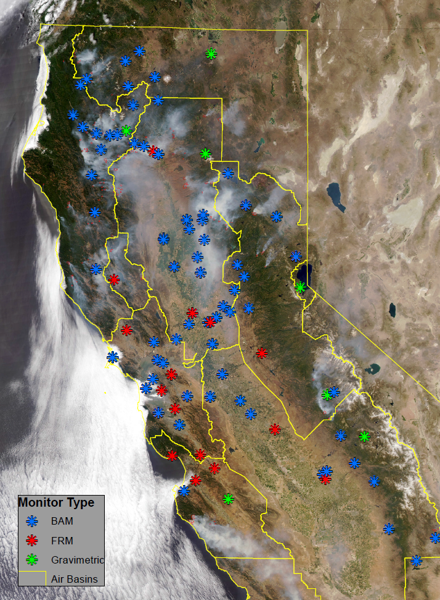
PM_{2.5} Monitoring Data
121 PM_{2.5} Monitors
EPA, CARB, USFS
38 FRM
16 other gravimetric
67 BAMs
Co-located FEM monitors agree with FRM (Pearson r values 0.94 – 1.00).

Slide 28
Statistical Methods – Machine Learning
29 predictor variables
121 monitoring locations
11 statistical algorithms
10-fold cross validation within each algorithm
To choose the covariates
To choose the tuning parameters of the algorithm
Minimize the CV-RMSE
Caret package in R
Functions rfe and train

